Slide 1

Functions
Notes:
Hi, in this video we’re going to learn how to use functions to make our code reusable and more readable.

Slide 2
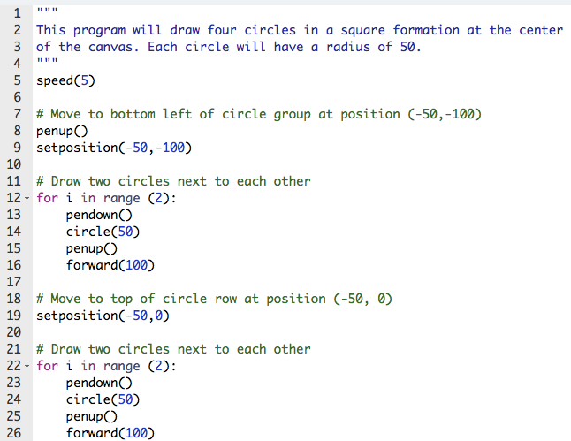
Look back at Four Circles
Instead, write a function!
Notes:
Let’s take a look back at our Four Circles program. The two loops that we wrote (Click for red boxes) are exactly the same. What if we were going to make a whole tower of these circles? We would need to write that loop over and over and over every time we needed to use it. This is where (Click for label) functions can help make our lives much easier.

Slide 3
What is a Function?
Functions are a way to group a set of commands so they can be called with one line of code.
Functions help us teach Tracy new commands using the ones she already knows!
Notes:
Functions are a way to group a set of commands so they can be called with one line of code. They are basically a way to teach Tracy new commands using the ones she already understands.

Slide 4
Why Use Functions?
Functions help us by:
Shortening our code
Making our code reusable
Making our code more readable
Notes:
Functions are very beneficial to us as coders. In the same way that loops shorten our code, functions only have to be defined once and then can be called as many times as we want with a single line of code.
Functions make our code reusable by allowing us to repeat a set of commands any time we’d like.
Functions also break our code up into smaller parts which increases readability. We use descriptive function names to make it known to the user what this piece of code is achieving.

Slide 5
Defining a Function
def function_name_here():
function commands here (indented!)
Function Name: my_function
Notes:
Before you can use a function, you must define it. This includes giving it a name and telling Tracy what commands you want to perform when you call that function.
To write a function definition, we start by using the term ‘def’ and then typing the name of our function, followed by a pair of parentheses and a colon. All of the commands we want Tracy to perform when we call our function must be indented underneath the function definition.
(Click for label) Don’t forget our naming rules when deciding on a name for your functions!

Slide 6
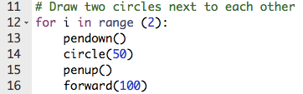
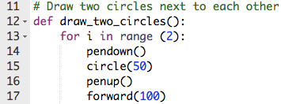
Defining a Function
def function_name_here():
function commands here
Define function
Notes:
Let’s look back at the part of our Four Circles program we want to turn into a function.
(Click for arrow and image) To define this function, we need to name it and we’ve decided here to call it draw_two_circles, which follows all of our naming rules.
Now let’s take a close look at the indentation. Our loop is being initialized on line 13 and is indented because it is a part of the function. Lines 14-17 are indented twice. Why is this? Well, one indent is to show that these commands are under the loop and the second indent is to show that they are also under the function. We’ll look at more examples of this in our code editor in a second.

Slide 7
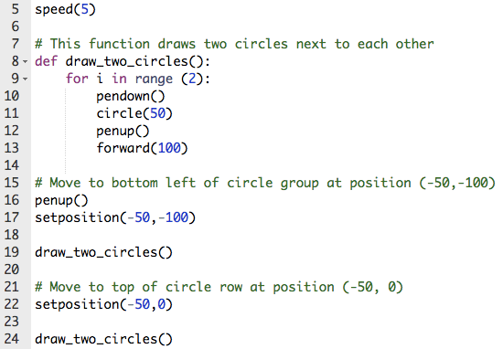
Calling a Function
To call a function:
function_name()
*Reminder! Functions must be defined before they are called.
Notes:
Once we have defined our function, we can call it throughout our code as many times as we want. Our Four Circles example has now been updated to show our function draw_two_circles being defined right after the speed statement. To be clear, defining a function does not mean that Tracy will follow any of the commands yet. Tracy will only complete the function when it is called.
So if we look at our code, the first command that Tracy will actually follow after setting her speed will be penup and setposition to -50, -100. After that we can see that the function draw_two_circles is being called. We are then changing Tracy’s position and calling our function once more.
It is very important to remember that functions cannot be called unless they have been defined earlier in the code. If you don’t tell Tracy what to do when you say draw_two_circles, she won’t recognize this phrase and will respond with an error.
Let’s go through an example to see functions in action.

Slide 8
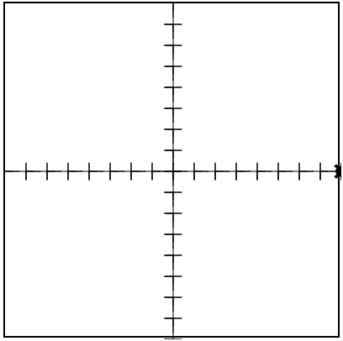
Example #1: X and Y Axes with Hash Marks
Write a program that has Tracy draw an x- and y- axis on the screen with hash marks every 25 pixels.
Notes:
In this example, we want to enhance the x- and y-axis program we previously wrote to now include hash marks every 25 pixels.

Slide 9
Commands Learned this Lesson
Command | What does it do?
def function_name(): | Declares a function
function_name() | Calls a function
Notes:
In this lesson, we learned how to declare and call functions. Refer to the examples we went through to help you use functions to solve some Tracy challenges of your own!

